Slide 1
Deep Features
In this worksheet, a several classifications were developed for person verification using CASIA-D Dataset.
Aim 1: To compare two different methods used to compute similarity scores for a template matching method
Euclidean distance vs. Correlation coefficient ​
Aim 2: To compare two different feature types:
Center-of-pressure (COP) vs. Center-of-area (COA)
Notes:
In this worksheet, a template matching model for verification task was developed.
The aim of this worksheet is to find the best model based on two different score matrixes.
In addition, we are going to compare COP and COA features.

Slide 2

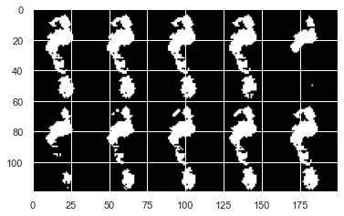
Processing Pipeline 1: Pre-Feature Extraction​
3D .
footprint* .
(60,40,100)
Extracting 10 pre-features for each sample
(60,40,10)
Concatenating Image features
(120,200,1)
Image features
* CASIA-D Dataset: 97 subjects, 2851 samples
* CD, PTI, Tmax, Tmin, P50, P60, P70, P80, P90, P100
Notes:
Let start with the block diagram of the feature extraction.
As you can see, at first, I extracted the COP time series from each sample.
in the next couple of slides, we can see these signals.
Then these were passed through a low-pass filter.
with cut-off frequency of 5-Hz.
Finally, 26 handcraft features were extracted.
So each 3D sample translated to a 26-element vector.
+/-4.1 (18, 54)

Slide 3
Processing Pipeline 1: Deep Feature Extraction​
preprocessing
Image features
Casting to tf.float32
(120,200,1)
Reshape to (120,200,3)
(120,200,3)
preprocess_input
CNN
Based CNN Model *
GlobalMaxPooling2D
Deep features
* Based CNN Model: "efficientnet.EfficientNetB0", vgg16.VGG16, resnet50.ResNet50,
Notes:
After extracting features, normalization and PCA were applied to these feature types.
In the next slide, I’d like to talk more about this red box.
Also, for comparing models, the accuracy was calculated.

Slide 4
Processing Pipeline 2: Feature Evaluation​
Enrollment Process
Deep features
Splitting test and training set
Normalization & PCA
Train SVM, KNN or Template Matching
Verification Process
Test set
Normalization & PCA
Calculating Accuracy, F1-score, FRR and FAR
Notes:
After extracting features, normalization and PCA were applied to these feature types.
In the next slide, I’d like to talk more about this red box.
Also, for comparing models, the accuracy was calculated.

Slide 5
Processing Pipeline 4: Verification Process​
Test Set
Training se
Client samples
Test Set
Verification Process
Client samples
SVM, KNN or Template Matching
Calculating Accuracy, F1-score and EER
Imposter samples
Randomly
Computing the average of Accuracy, F1-score, FAR and FRR
Imposter samples
It would repeat 50 times.
Notes:
Here we can see the same method that I have used for the verification process.

Slide 6
Conditions for Worksheet 3​
Classifier
SVM
Deep features
vgg16
KNN
Template Matching
inception_v3
efficientnet
Notes:
As I said before, our purpose is to compare several algorithms to find out which one has the best performance.
So, This table shows the search space for this worksheet.

Slide 7
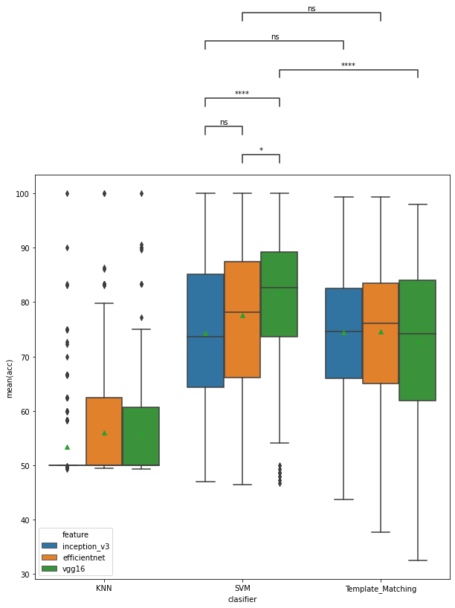
Deep features
Statistical test: Mann-Whitney
p-value annotation legend:
ns: 5.00e-02 < p <= 1.00e+00
*: 1.00e-02 < p <= 5.00e-02
****: p <= 1.00e-04
Notes:
slide 28
about PCA, the performance of models decreased since we lost some variance.
But I think keeping 95 percent could be a good choice
because it reduces feature space by about one-fourth with the same accuracy as without PCA.

Slide 8
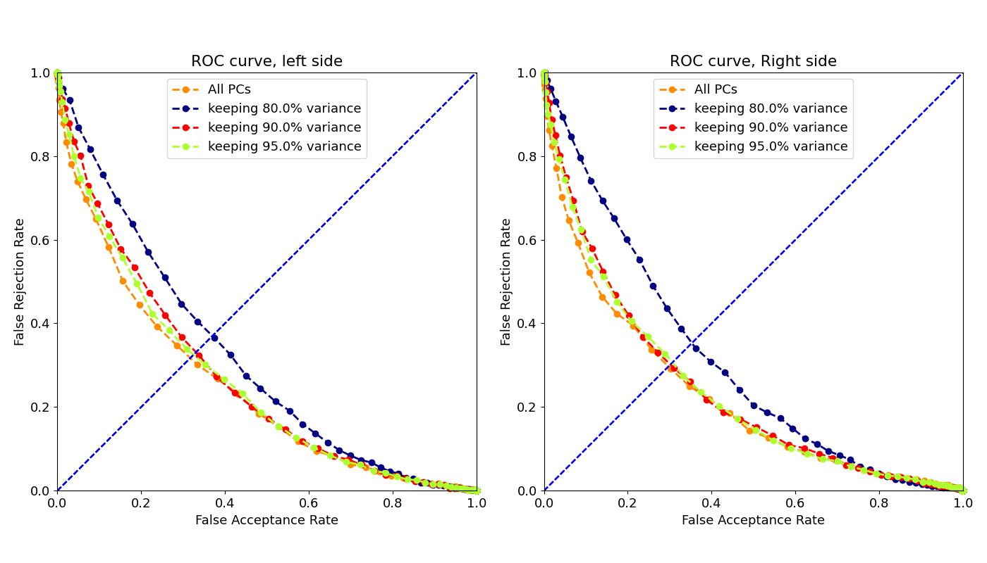
Principal Component Analysis (ROC)
For each subject, two models were developed, left and right. As a result, we have 2*96 models, and these two plots are obtained from the average of FAR and FRR in these models.
Notes:
slide 29 & 30
here is a boxplot of accuracy and ROC curve.

Slide 9
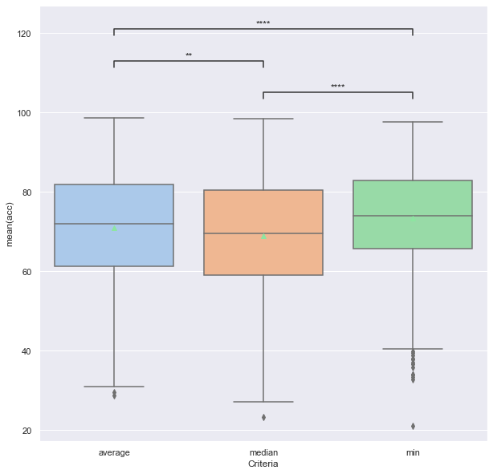
Template Matching Criterion​
Statistical test: Mann-Whitney
**: 1.00e-03 < p <= 1.00e-02
****: p <= 1.00e-04
Features Type | COP features
Normalization algorithm | Z-score, Min-Max
Score matrix | Distance
PCA | Without PCA, Keeping 95% variance, Keeping 90% variance, Keeping 80% variance
Notes:
slide 31
about template matching, minimum distance has better accuracy and lower EER than median and average.

Slide 10
Template Matching Criterion​
For each subject, two models were developed, left and right. As a result, we have 2*96 models, and these two plots are obtained from the average of FAR and FRR in these models.
Notes:
slide 33
so based on the best condition, the COA time series has better results among other feature types.

Slide 11
Conclusions
Minimum distance has a better result than median and average.
Although applying PCA has reduced the accuracy, It was selected since it reduced the feature space.
In time-series, the number of features with keeping 95% variance decreased from 300 to about 16.
In handcraft features, the number of features with keeping 95% variance decreased from 26 to about 6.
Z-score has a better result in comparison with Min-Max.
30% test size provided a good trade-off between test samples and accuracy.
COA Time-Series has better results in comparison with other types of features.

